Slide 1
Customer Meeting
January 20th

Slide 2
Agenda
Our original goals for the last iteration
Our progress
Issues we had
Missed objectives
Next iteration goals and Risk
Questions

Slide 3
Original Goals for Iteration 1 (Dec 12-Jan 20)
Finish wireframes for whichever option we've agreed on/has been approved by Louise & Vicky​
Create static HTML/CSS pages​
Create Models ​
Create Population Script​
Research initial test coverage

Slide 4
Our progress
Finish wireframes for whichever option we've agreed on/has been approved by Louise & Vicky​

Slide 5
Our progress
Finish wireframes for whichever option we've agreed on/has been approved by Louise & Vicky​
Create static HTML/CSS Pages

Slide 6
Our progress
Finish wireframes for whichever option we've agreed on/has been approved by Louise & Vicky​
Create static HTML/CSS Pages
Create Models

Slide 7
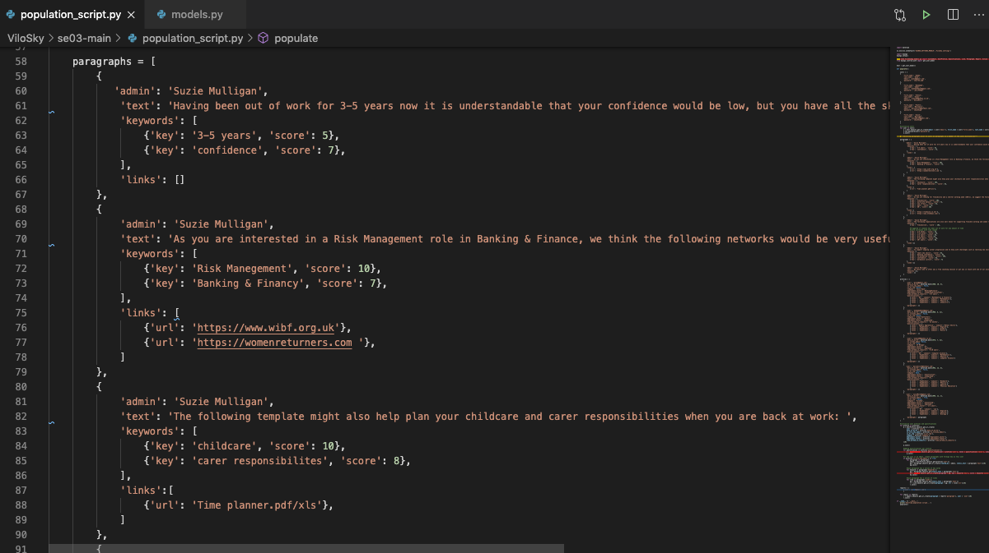
Our progress
Finish wireframes for whichever option we've agreed on/has been approved by Louise & Vicky​
Create static HTML/CSS Pages
Create Models
Create Population Script
Initial test suite design

Slide 8
Our progress
Finish wireframes for whichever option we've agreed on/has been approved by Louise & Vicky​
Create static HTML/CSS pages
Create models
Create population script
Research initial test coverage

Slide 9
Issues we had
ER Diagram – needed tweaking/revisiting to perfect models
Population script was sizeable, and we still need to flesh it out

Slide 10
Missed Objectives
IP – Come to an agreement maybe need written agreement

Slide 11
Next iteration goals & Risk
Complete Population Script (Medium Risk)
Finishing static HTML/CSS pages (minor) (Low Risk)
Implementing test coverage (Medium Risk)
User consent form (T&C and Privacy Policy) (Low Risk)
Create a generic report (output) component in a web client which would display results from the backend (High Risk)
Create submission form (can be depersonalized - for HR) (High Risk)
Login/Logout functionality + forgot password (email) (Low Risk)

Slide 12
Questions
Would you be able to construct another pathway for us in the next week or so?

